Slide 1
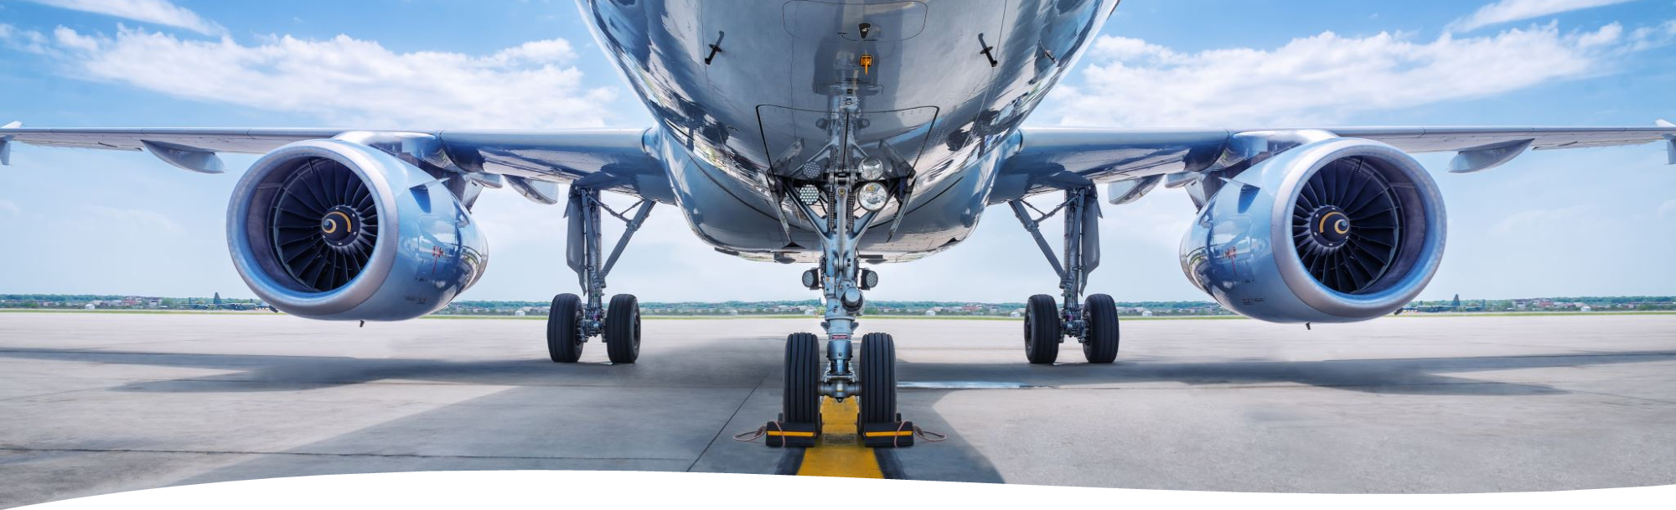

An Analysis of Flight Delay in the US
Presented By:
Avinash Rajendran (989445071)
Akilan Kumaran (989444731)
Nidhi Mange (989442915)
Deepika Vemu (989444730)
Saarah Susmitha Mylapalli (98944)

Slide 2

Abstract
This report presents an analysis of flight delay in the US using data from the Bureau of Transportation Statistics (BTS) of 2015
The aim is to identify the major causes of flight delay and their impact on airline performance
The analysis uses descriptive statistics, correlation analysis, and regression analysis to explore the relationships between flight delay and various factors such as weather conditions, airline size, and airport congestion

Slide 3

Introduction
Air travel is an essential part of modern society, providing fast and efficient transportation for millions of people every day
However, as air traffic volume continues to increase, so does the risk of flight delays, which can cause significant inconvenience for passengers and financial losses for airlines
The United States is one of the world's busiest aviation markets, with thousands of flights taking off and landing every day across a vast network of airports and airlines
The aim is to provide an analysis of flight delay in the US, focusing on the causes, patterns, and impacts of delay events on both airlines and passengers

Slide 4

Project Objective
The objective is to analyze flight delay in the US using data from BTS(Bureau of Transportation Statistics) and identify the major causes and impacts of flight delay on airline performance

Slide 5
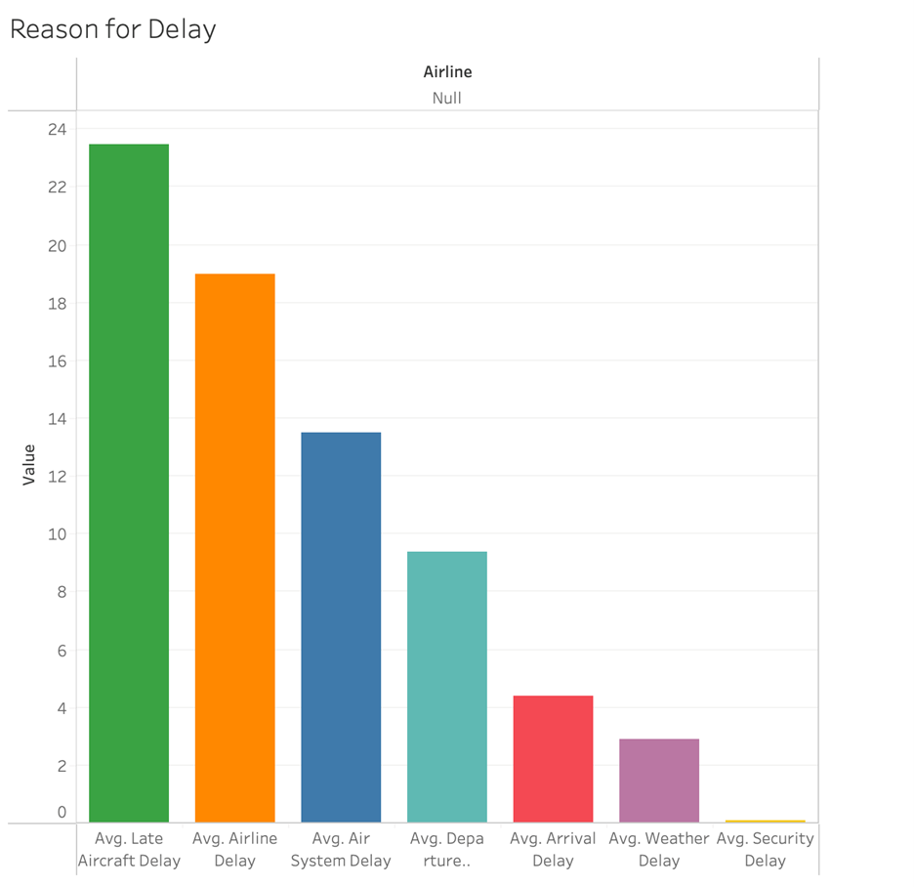
Visualization of Flight delays by Reason
Flight delays are caused by various reasons
The analysis shows that weather conditions, arrival delay, departure delay, security delay and airline delay are significant factors affecting flight delay
The analysis also shows that flight delay has a significant negative impact on airline performance, including on-time arrival and customer satisfaction

Slide 6
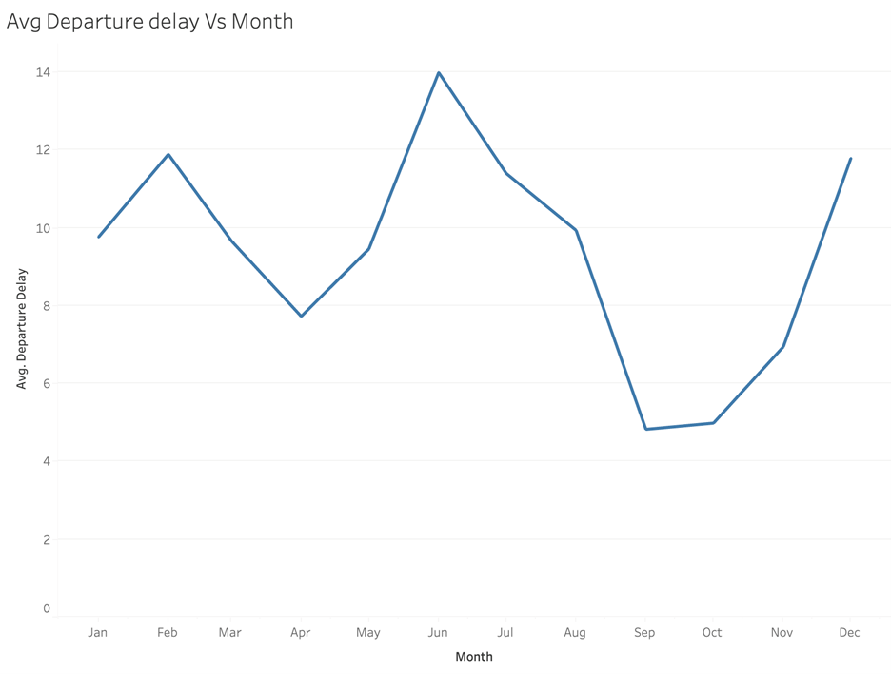
Findings
With an average departure delay of 4.8 minutes, the month of September is the best time to go
June, which is in the middle of the year, has the longest average departure delay, which is 14 minutes

Slide 7
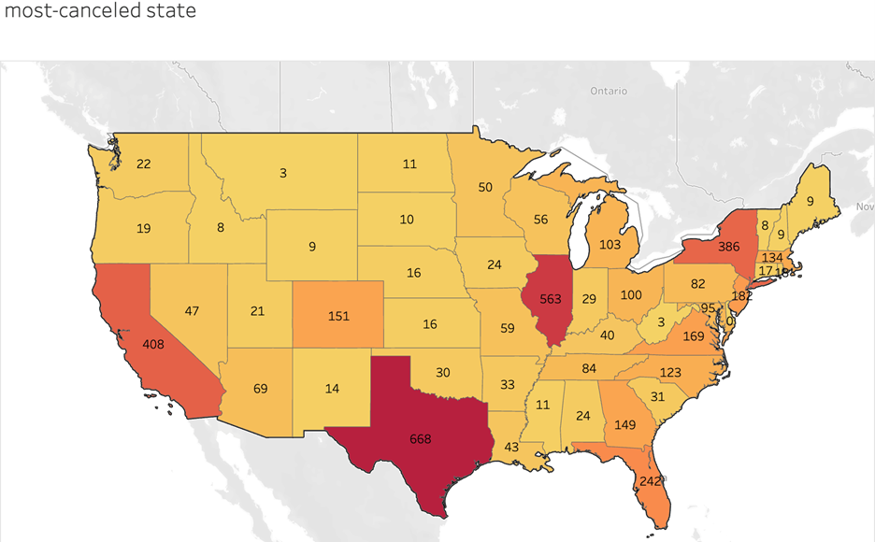
Most Cancellation by State
The largest number of flight cancellations, 668, occurred in the American state of Texas
When considering that Montana has the fewest flight cancellations of the three states (Texas), it might not be a good idea to visit there

Slide 8
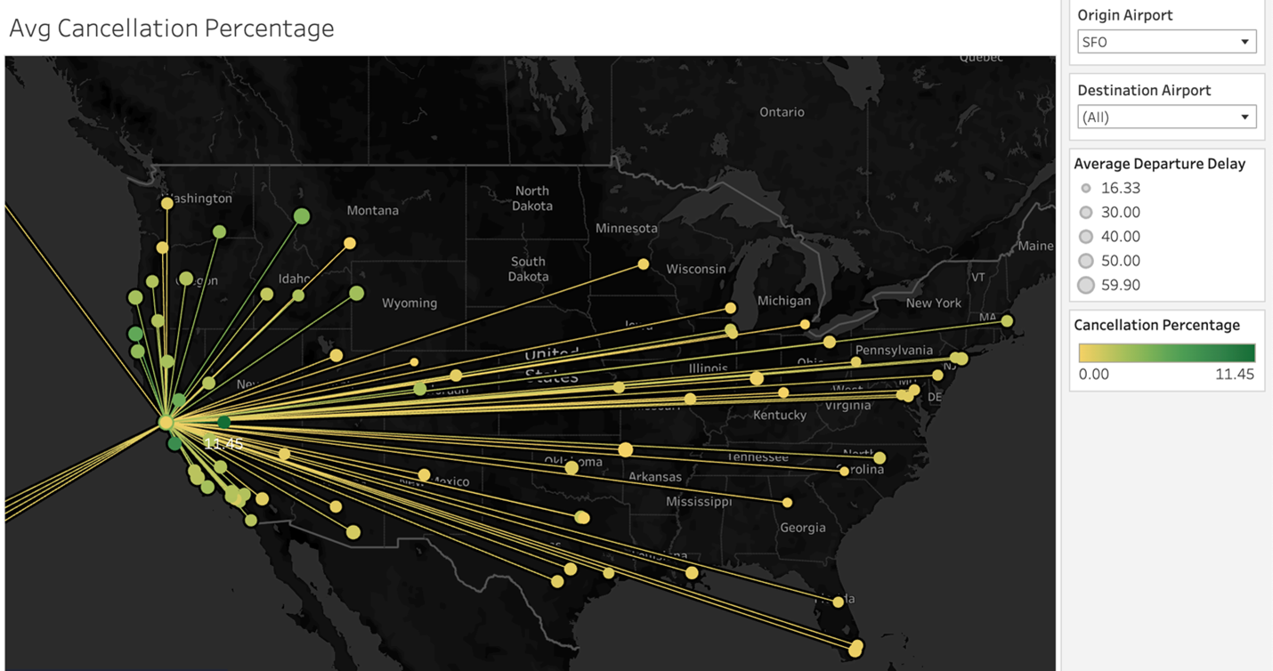
Average Cancellation Percentage
An examination of the flights between each source and destination combination
Both the highest percentage of cancellations (11.4%) and the longest average departure delay (40.20 minutes) were experienced by the aircraft from SFO to MMH
SFO to MRY was next, with a 43-minute delay in departure and an 8.38% cancellation rate

Slide 9
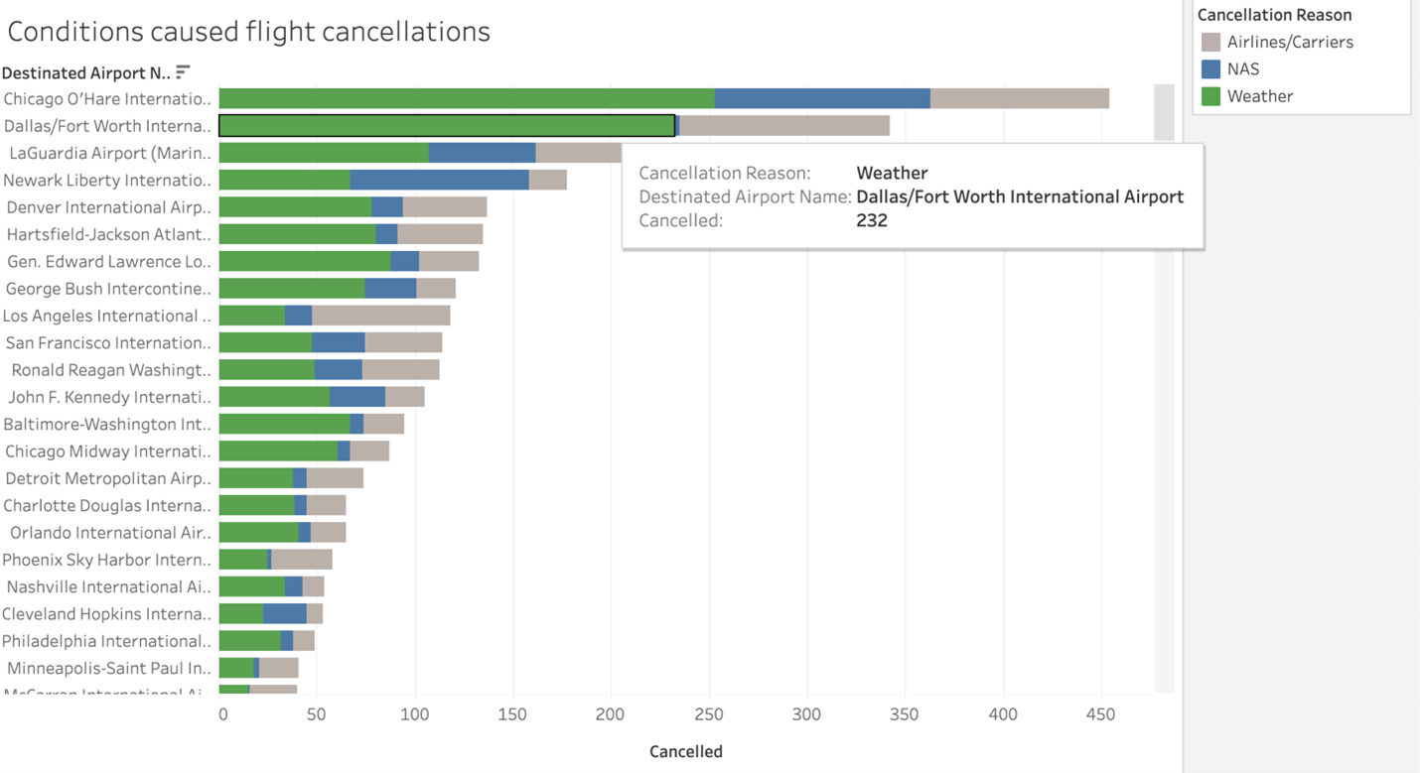
Conditions Caused Flight Cancellation
The top three airports with the highest number of delays were Chicago O'Hare International Airport, Dallas/Fort Worth International Airport, and LaGuardia Airport
The majority flight cancellations among the airports were at Chicago O'Hare International Airport in 2015, with around 454 cancellations total
The weather, which accounts for 253, was the main factor that caused the flight to be canceled, followed by the NAS with 110 and the airlines with 91

Slide 10
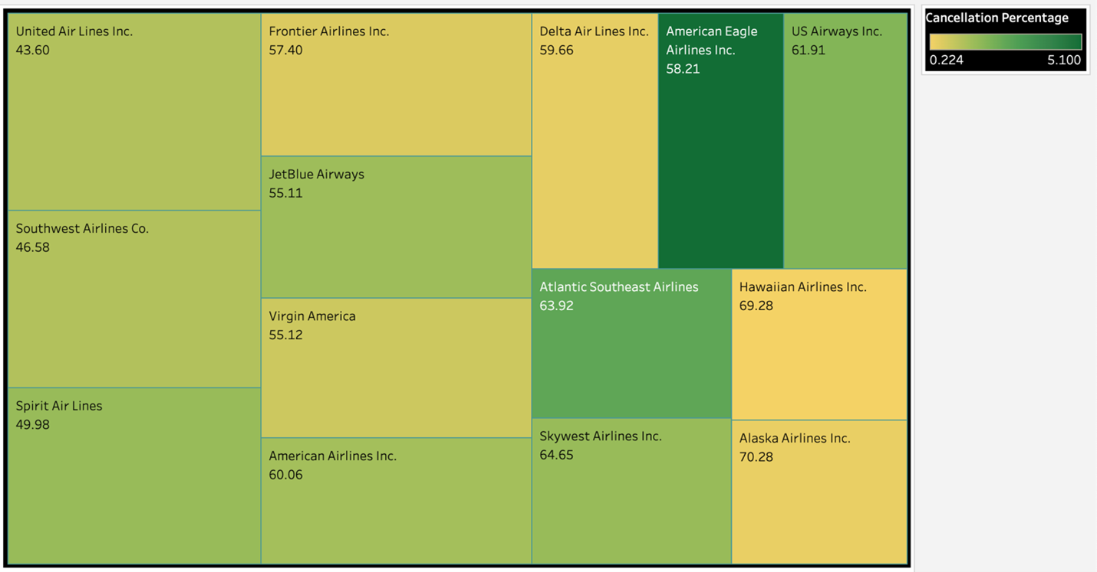
Cancellations According to Airlines
American Eagle Airlines and Atlantic Southeast Airlines had the largest rate of cancellations (5.1% and 2.663%, respectively), while Hawaiian Airlines had the lowest percentage (0.224%)

Slide 11
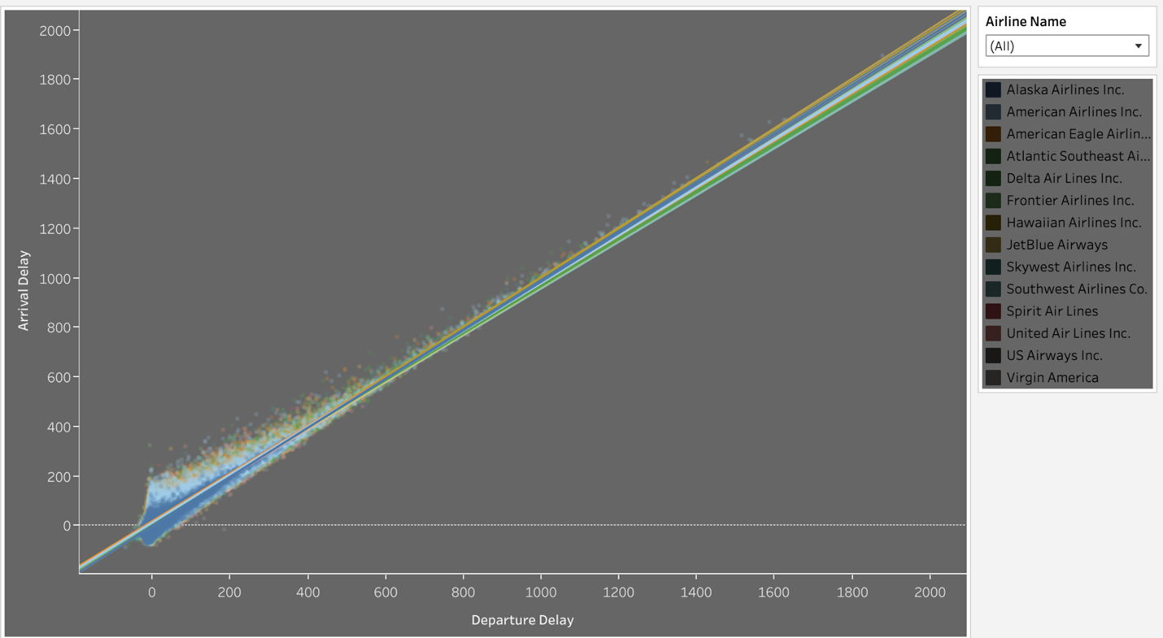
Correlation by Departure delay and Arrival delay
The number of flights scheduled and operated was the highest in the month of July, followed by August, June, and May
The average delay time for all flights was approximately 14 minutes, and the average cancellation rate was around 1.5%

Slide 12
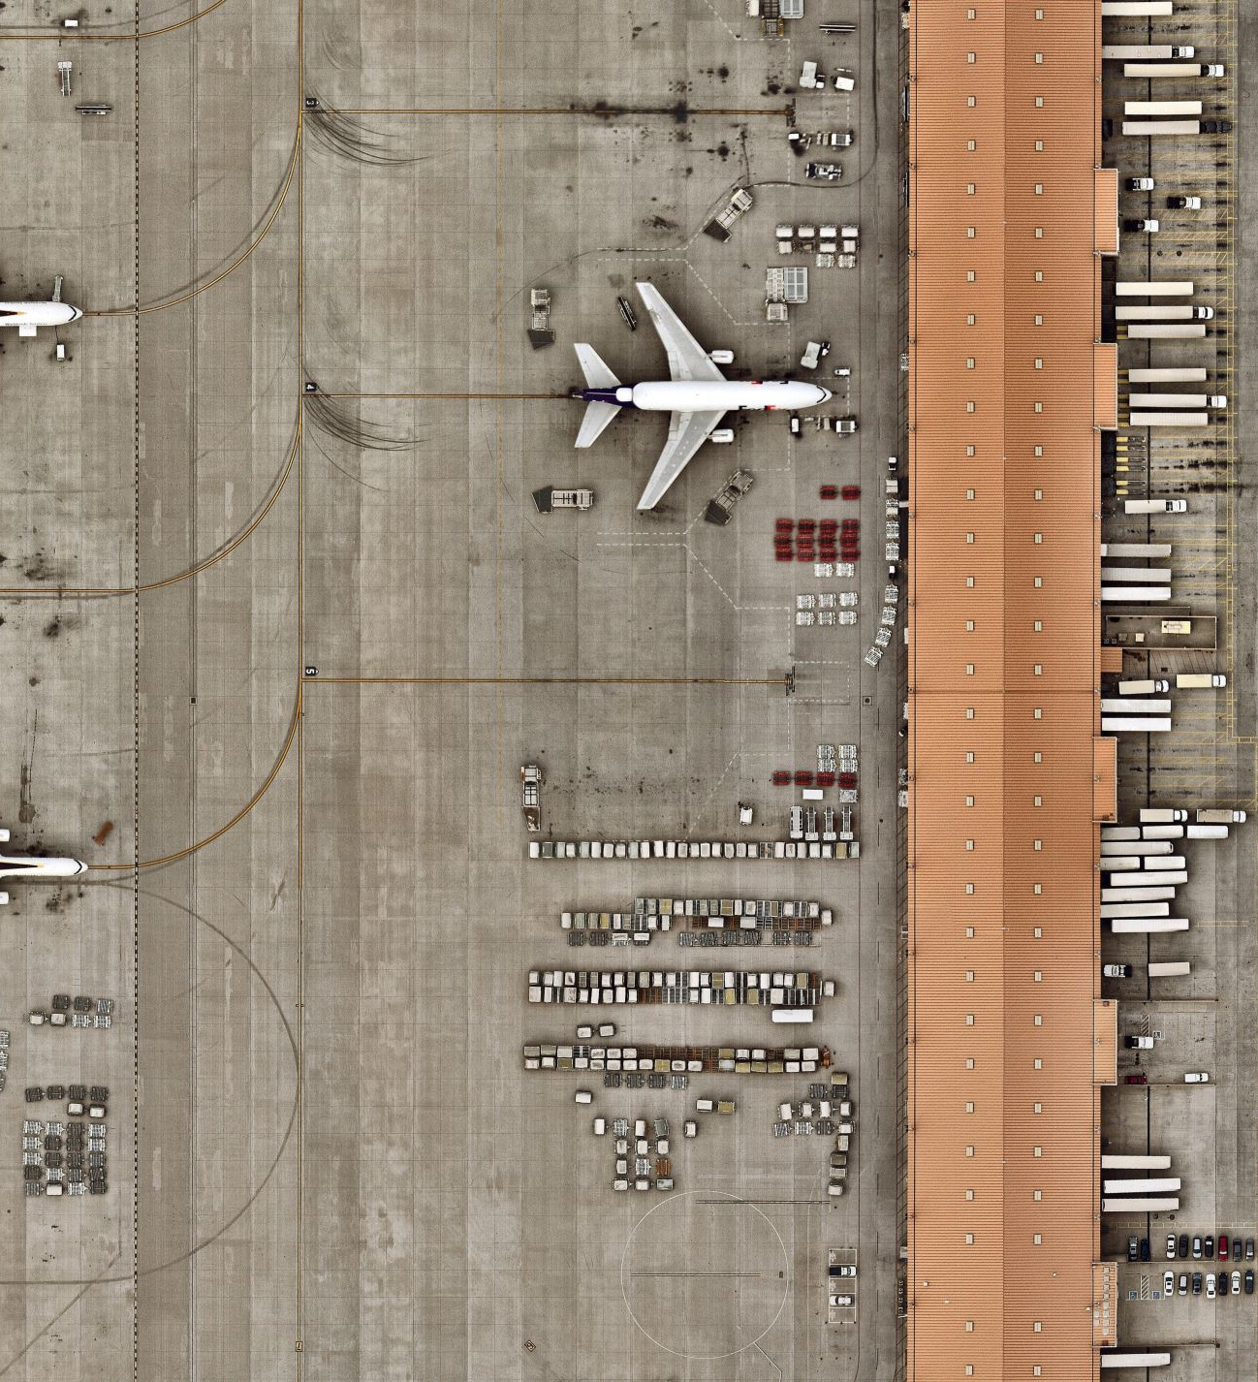
Managerial Implication
The analysis of flight delays in the US provided several insights and ideas that can be shared with others
By using tools like Tableau, analysts can create compelling visualizations that make it easier for decision-makers to understand and act on the data

Slide 13
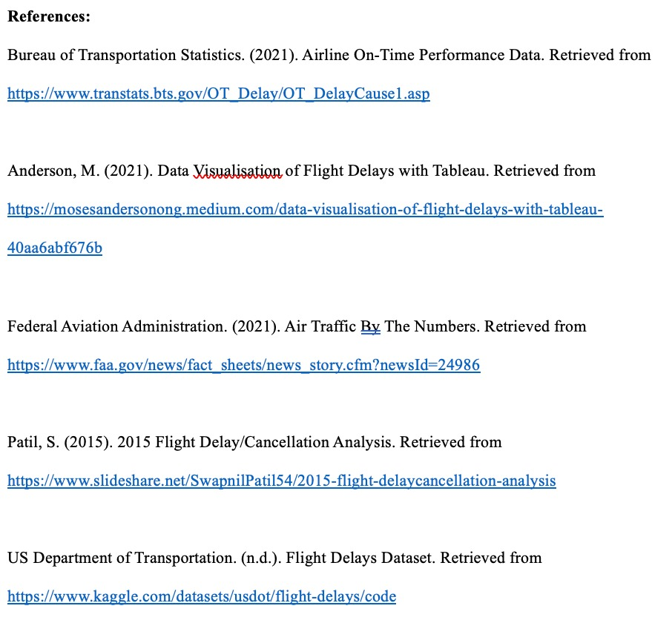
References

Slide 14
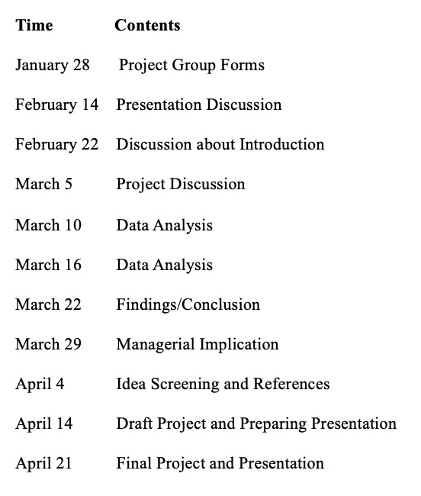
Appendix

Slide 15
Thank you

